Slide 1


Exercise: Organizing, Loading, and Publishing Point Observations Using HydroServer
CUAHSI
HIS
Sharing hydrologic data
http://his.cuahsi.org/
Jeffery S. Horsburgh
David G. Tarboton, Kimberly A. T. Schreuders, David R. Maidment, Ilya Zaslavsky, and David Valentine
And the Rest of the CUAHSI HIS Team
Support
EAR 0622374

Slide 2
In this Exercise
GOAL: Publish observational data for a site in the Little Bear River using HydroServer in about an hour
HydroServer Training Machine
http://hydroserver.uwrl.usu.edu
Windows Server 2008 R2
Microsoft SQL Server 2008 R2
HydroServer Software (ODM Tools and data loaders)

Slide 3
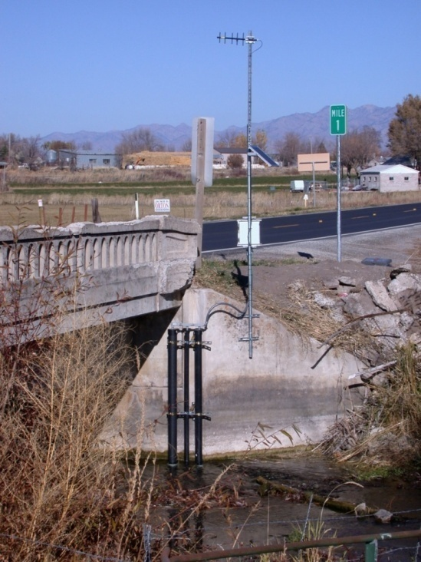
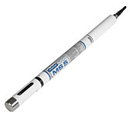
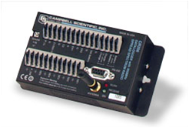

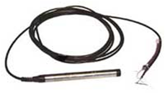
The Data You Will be Using
7 water quality and streamflow monitoring sites
Temperature
Dissolved Oxygen
pH
Specific Conductance
Turbidity
Water level/discharge
2 weather stations
Temperature
Relative Humidity
Solar radiation
Precipitation
Barometric Pressure
Wind speed and direction
Spread spectrum radio telemetry network

Slide 4
Publish Point Observations
Create an ODM database
Load site, variable, method, and source information using the ODM Data Loader
Load observations using the ODM Streaming Data Loader
Visualize and explore the data using ODM Tools
Publish the data by creating a WaterOneFlow web service

Slide 5
ODM Data Loader
Loading data to any table in ODM – e.g., Sites, Variables, Methods, etc.
Loading Data Values in serial format
Multiple sites and variables in one file
All data values in a single column
Site | Variable | Date | Value
1 | Temperature | 8/2/2007 14:00 | 12.4
1 | Temperature | 8/2/2007 14:30 | 12.7
1 | Temperature | 8/2/2007 15:00 | 13.1
… | … | … | …
1 | Dissolved Oxygen | 8/2/2007 14:00 | 9.78
1 | Dissolved Oxygen | 8/2/2007 14:30 | 9.70
1 | Dissolved Oxygen | 8/2/2007 15:00 | 9.56
… | … | … | …
2 | Specific Conductance | 8/2/2007 14:00 | 351.7
2 | Specific Conductance | 8/2/2007 14:30 | 350
2 | Specific Conductance | 8/2/2007 15:00 | 351.2

Slide 6
ODM Streaming Data Loader
Focused on loading data values
Crosstab data
Single site, multiple variables
Date in one column, each variable in one column
Datalogger files from field sensors
Date | Variable_1 | Variable_2 | … | Variable_n
8/2/2007 14:00 | 13.01298 | 1.155137 | … | 9.391667
8/2/2007 14:30 | 13.222 | 1.15333 | … | 9.586666
8/2/2007 15:00 | 13.19934 | 1.153291 | … | 9.75
8/2/2007 15:30 | 13.19094 | 1.153561 | … | 9.78
8/2/2007 16:00 | 13.17751 | 1.16075 | … | 9.703334
… | … | … | … | …

Slide 7
Questions?
CUAHSI
HIS
Sharing hydrologic data
http://his.cuahsi.org/
Support
EAR 0622374

